Slide 1

Invited talk: Bioinformatics x AI
Week 1 - Basics of Artificial Intelligence
Lecturer：Dongzhan Zhou
Date：

Slide 2
讲师介绍
周东展 博士
上海人工智能实验室 青年科学家
主要研究方向为AI for Science，包括Sci-LLM&VLM，AI4Computing，科学具身智能和自动化实验室等，关注AI在物理和生物领域的应用
南京大学物理学学士，悉尼大学人工智能博士，师从欧阳万里教授
在人工智能和物理学顶级期刊和会议上发表论文十余篇
联系方式：zhoudongzhan@pjlab.org.cn

Slide 3

Lecture Plan
Week 1 - Basics of Artificial Intelligence
Week 2 - Intro to Deep Learning
Week 3 - Intro to LLMs

Slide 4
Outline of Week 1
Basic Concepts of AI
History of AI
Intro to Neural Networks

Slide 5
1 | Basic Concepts of AI

Slide 6
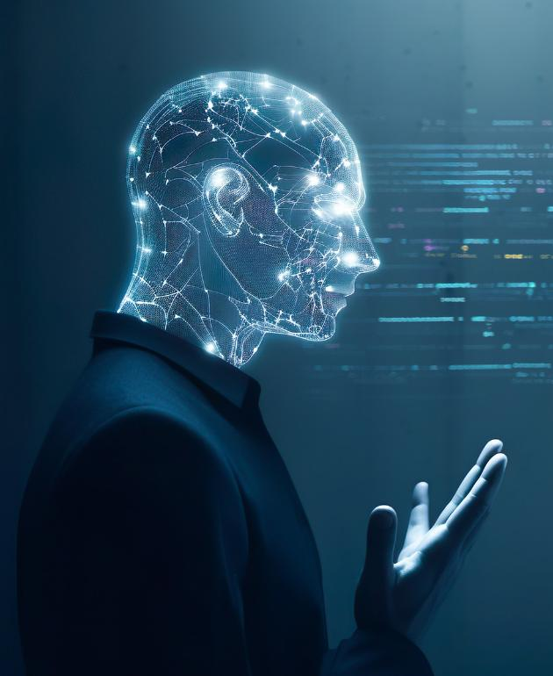
What is AI
Various Definitions
Science/Technique: AI is the simulation of human intelligence processes by machines, especially computer systems.
Engineering/Practice: AI develops systems that perceive, reason, and act to achieve goals.
Business: AI automates tasks requiring human intelligence, optimizing resources and cutting expenses.
……
Notes:
给多个定义

Slide 7
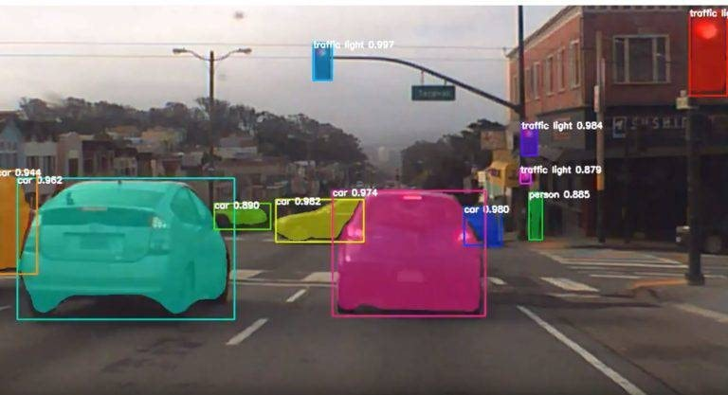
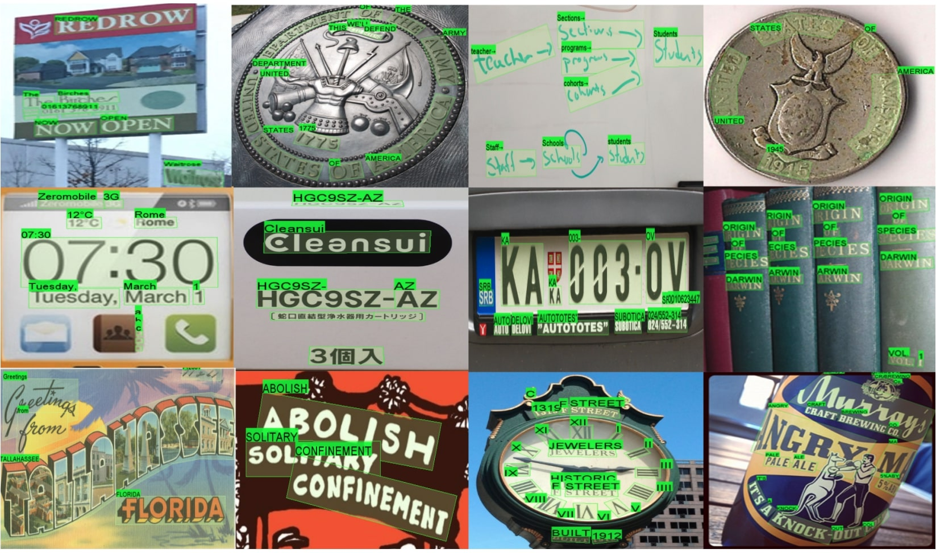

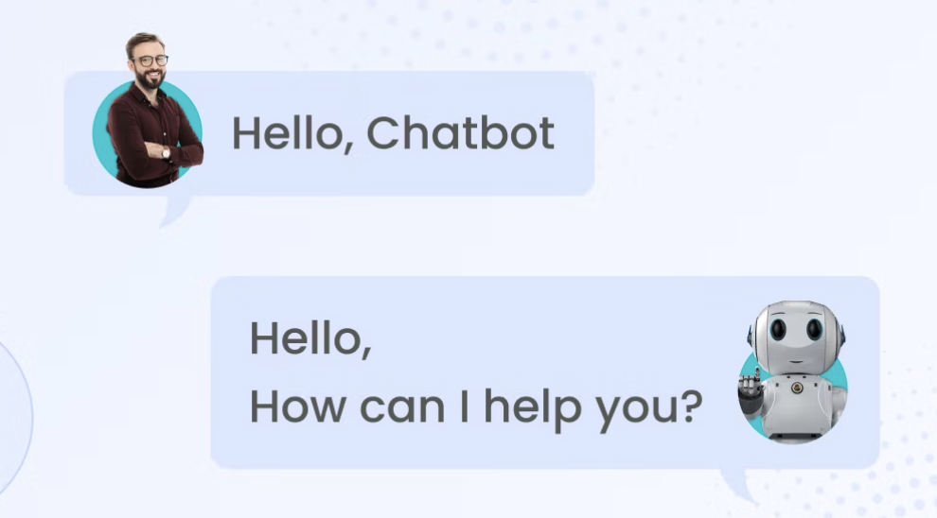
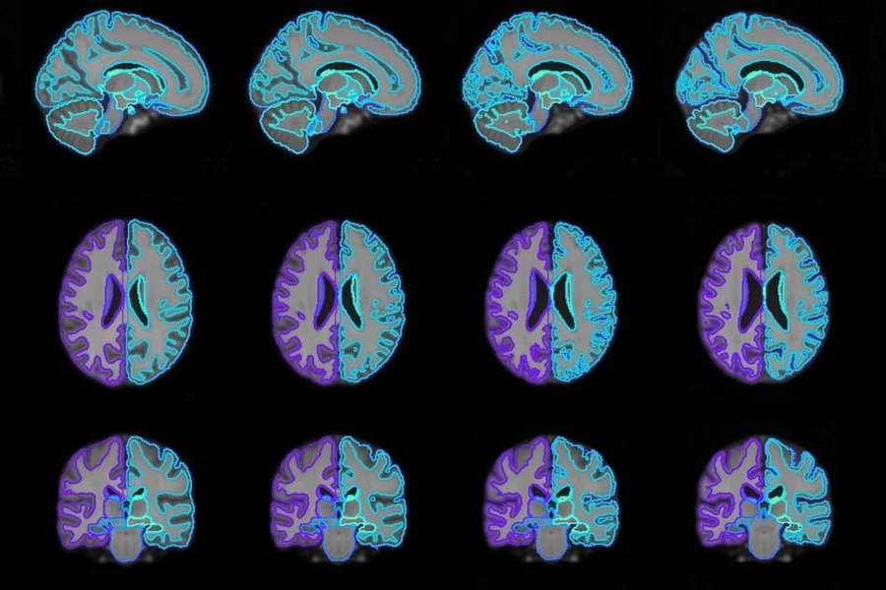
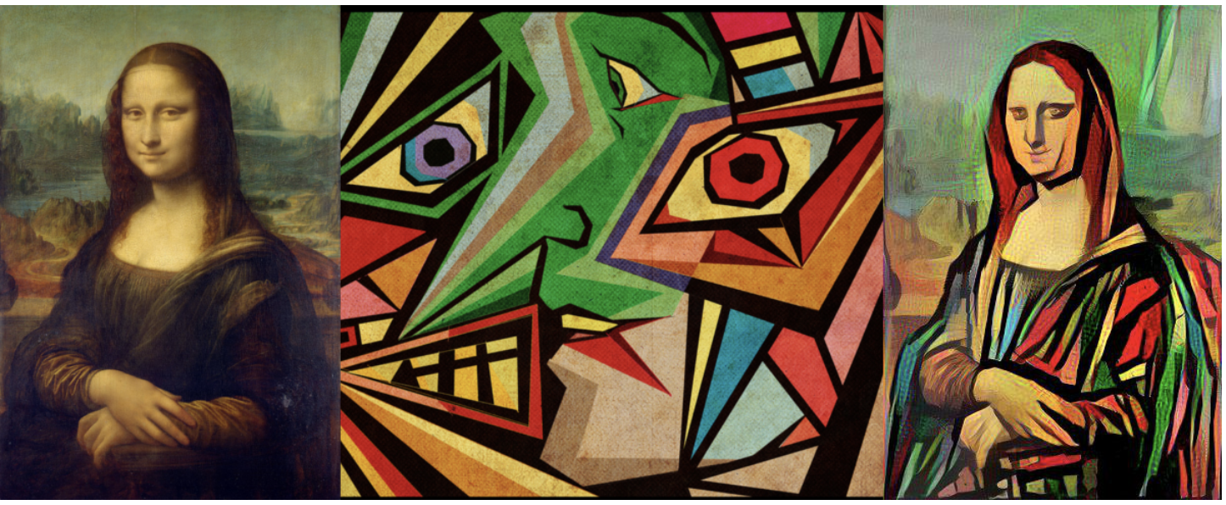
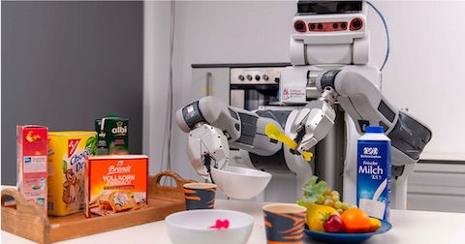
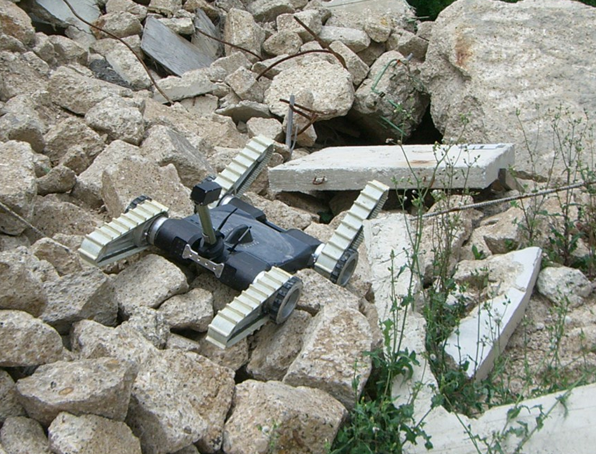
Application of AI
Computer Vision
Natural Language Processing
Auto Pilot
Character Recognition
Machine Translation
Chatbot
Robot
Medical Image Analysis
Style Transfer
Emergency Rescue
Housework

Slide 8
Human, Program, and AI
Experience
Rule
Data
Induction
Input
Train
Interpretation
New Problem
Rule
Input
Program
Compute
New Data
Input
Model
Predict
Future
Data
Result
Attribute
Human Thinking
Through experience, identify rules, and use the rules to predict the future.
Program
Based on predefined rules, execute calculations to obtain results.
AI
Extract rules from existing data and use them to predict outcomes for new data.
Notes:
人类通过经验找到规律，再利用规律去演绎未来

Slide 9
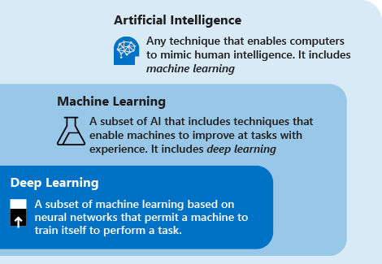
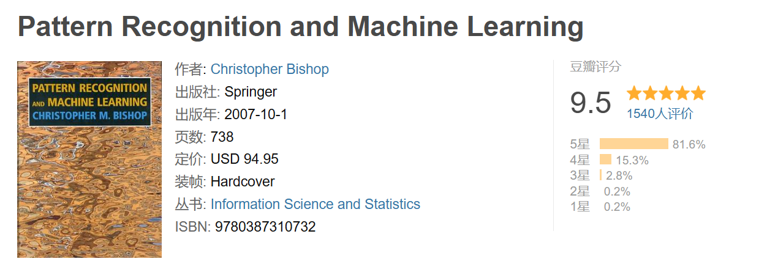
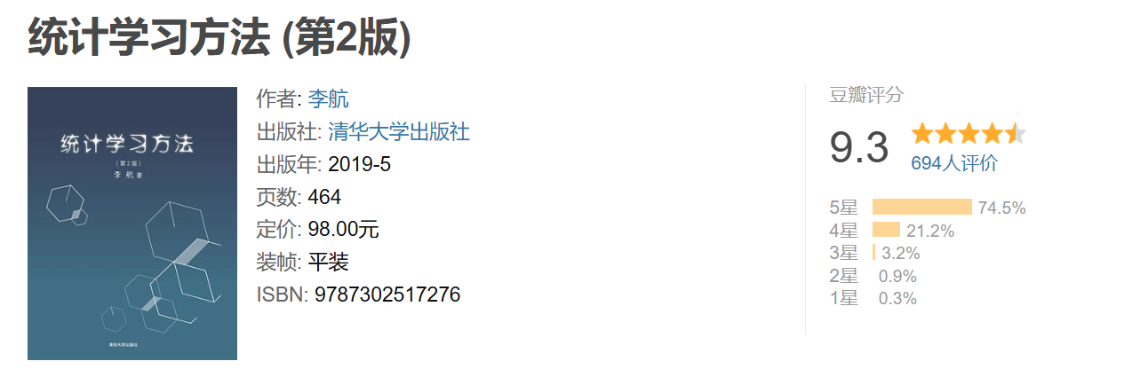
Machine Learning, Deep Learning and AI

Slide 10
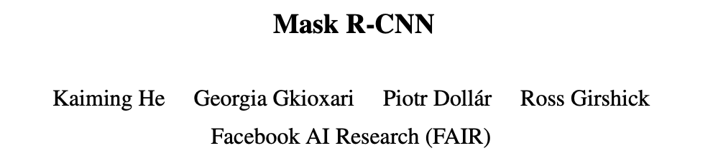
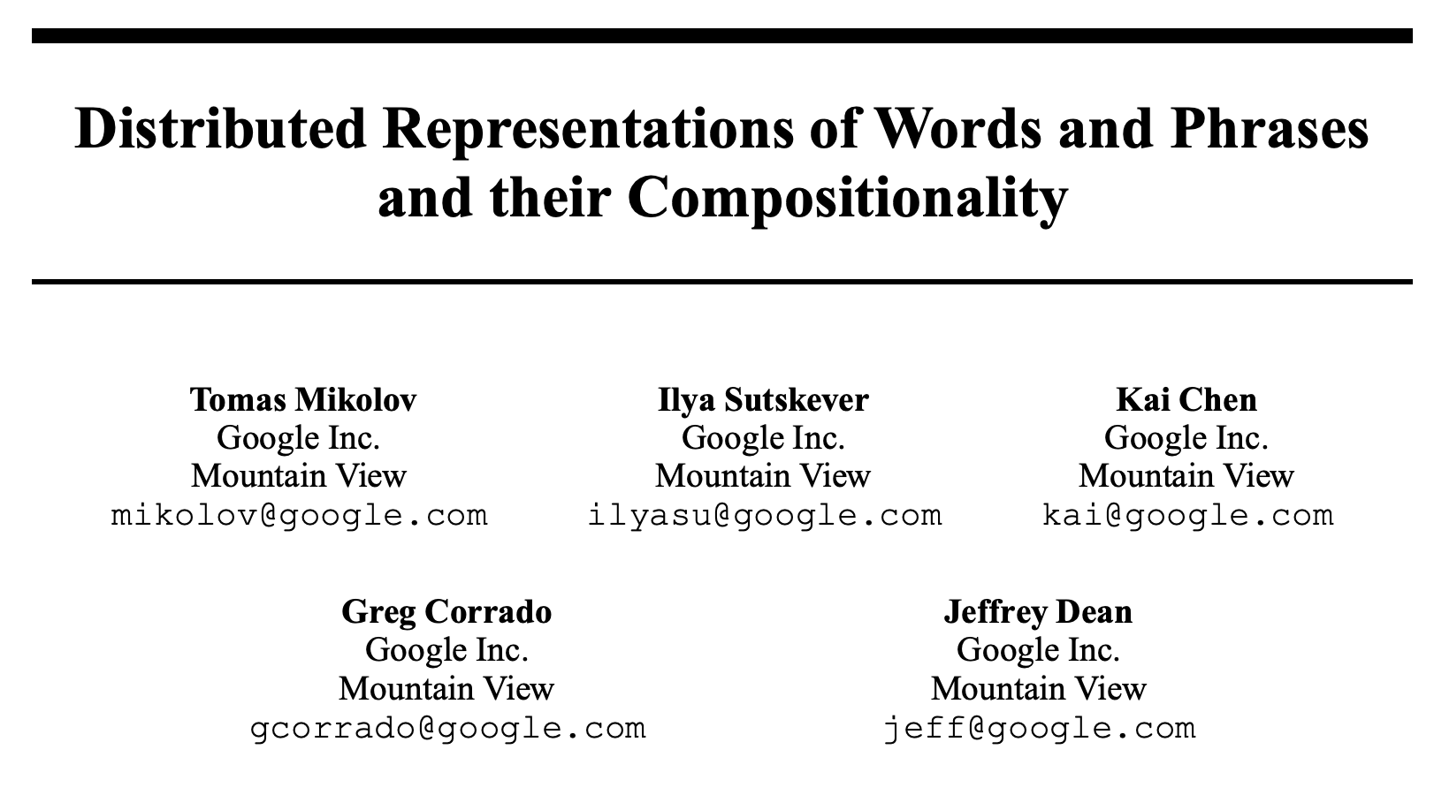
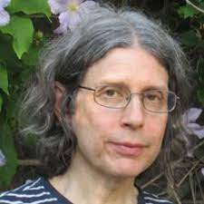
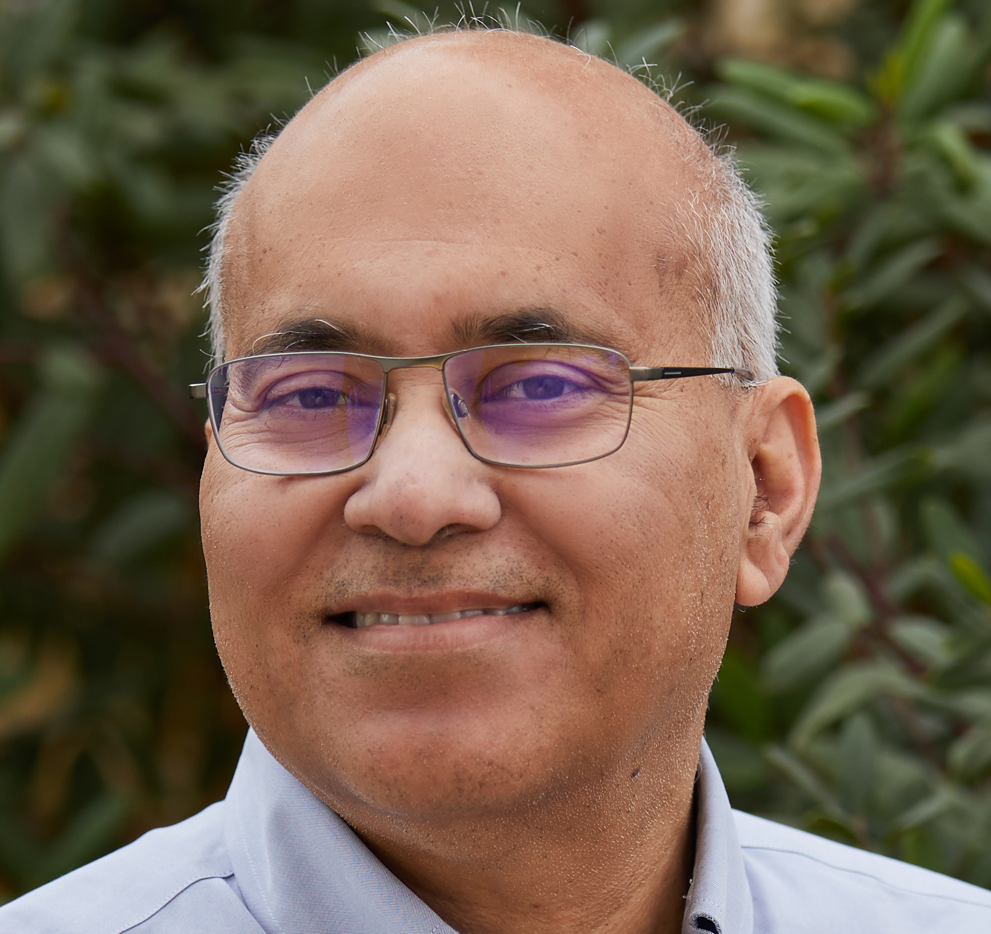

Top-tier Conferences, Journals, and Awards
Conference：NeurIPS、ICML、ICLR、IJCAI、AAAI、CVPR、ICCV、ECCV、ACL、NAACL、EMNLP, etc.
Journal：AI、JMLR、TPAMI、IJCV、TIP、CL、TACL
Mask R-CNN, ICCV 2017 Marr Prize
Andrew Zisserman
Jitendra Malik
Yann Lecun
PAMI Distinguished Researcher Award
Word2Vec, NeurIPS 2023, Test of Time Award
https://www.ccf.org.cn/Academic_Evaluation/AI/
https://www.core.edu.au/home

Slide 11




Submit your papers to a conference
NeurIPS Important Dates
Notes:
AI这个领域区别于其它研究领域的特点是，他的会议论文特别重要。像是孙老师做生物信息学，他发表过很多的nature这类超级期刊，我之前做物理研究的时候，物理会议一般也不接受长文章投稿，一般都接受一些进展快报，会议只是大家交流期刊论文的一个场地，但是对AI这个迭代速度非常快的领域来说，会议论文是一个重要的发表学术成果的途径。用neurips 2024的官网上的一个截图做例子，我给大家介绍一下一般AI论文接收的一个周期，还有我们AI从业者每天的工作内容是什么。

Slide 12
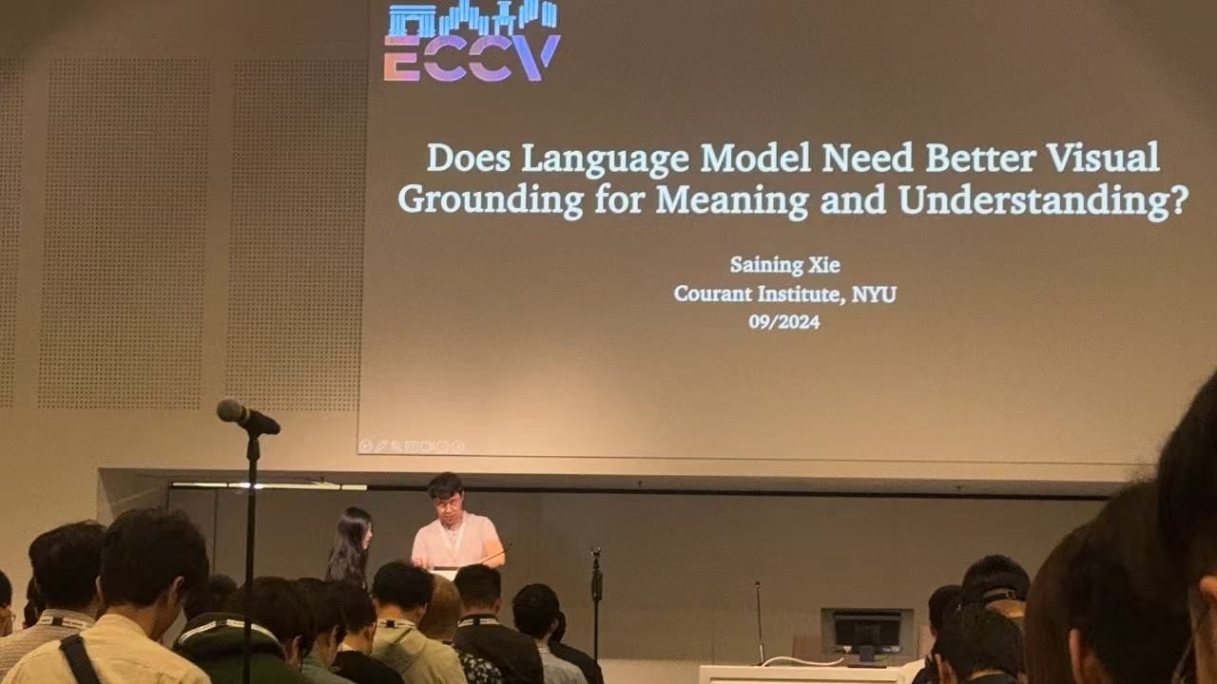
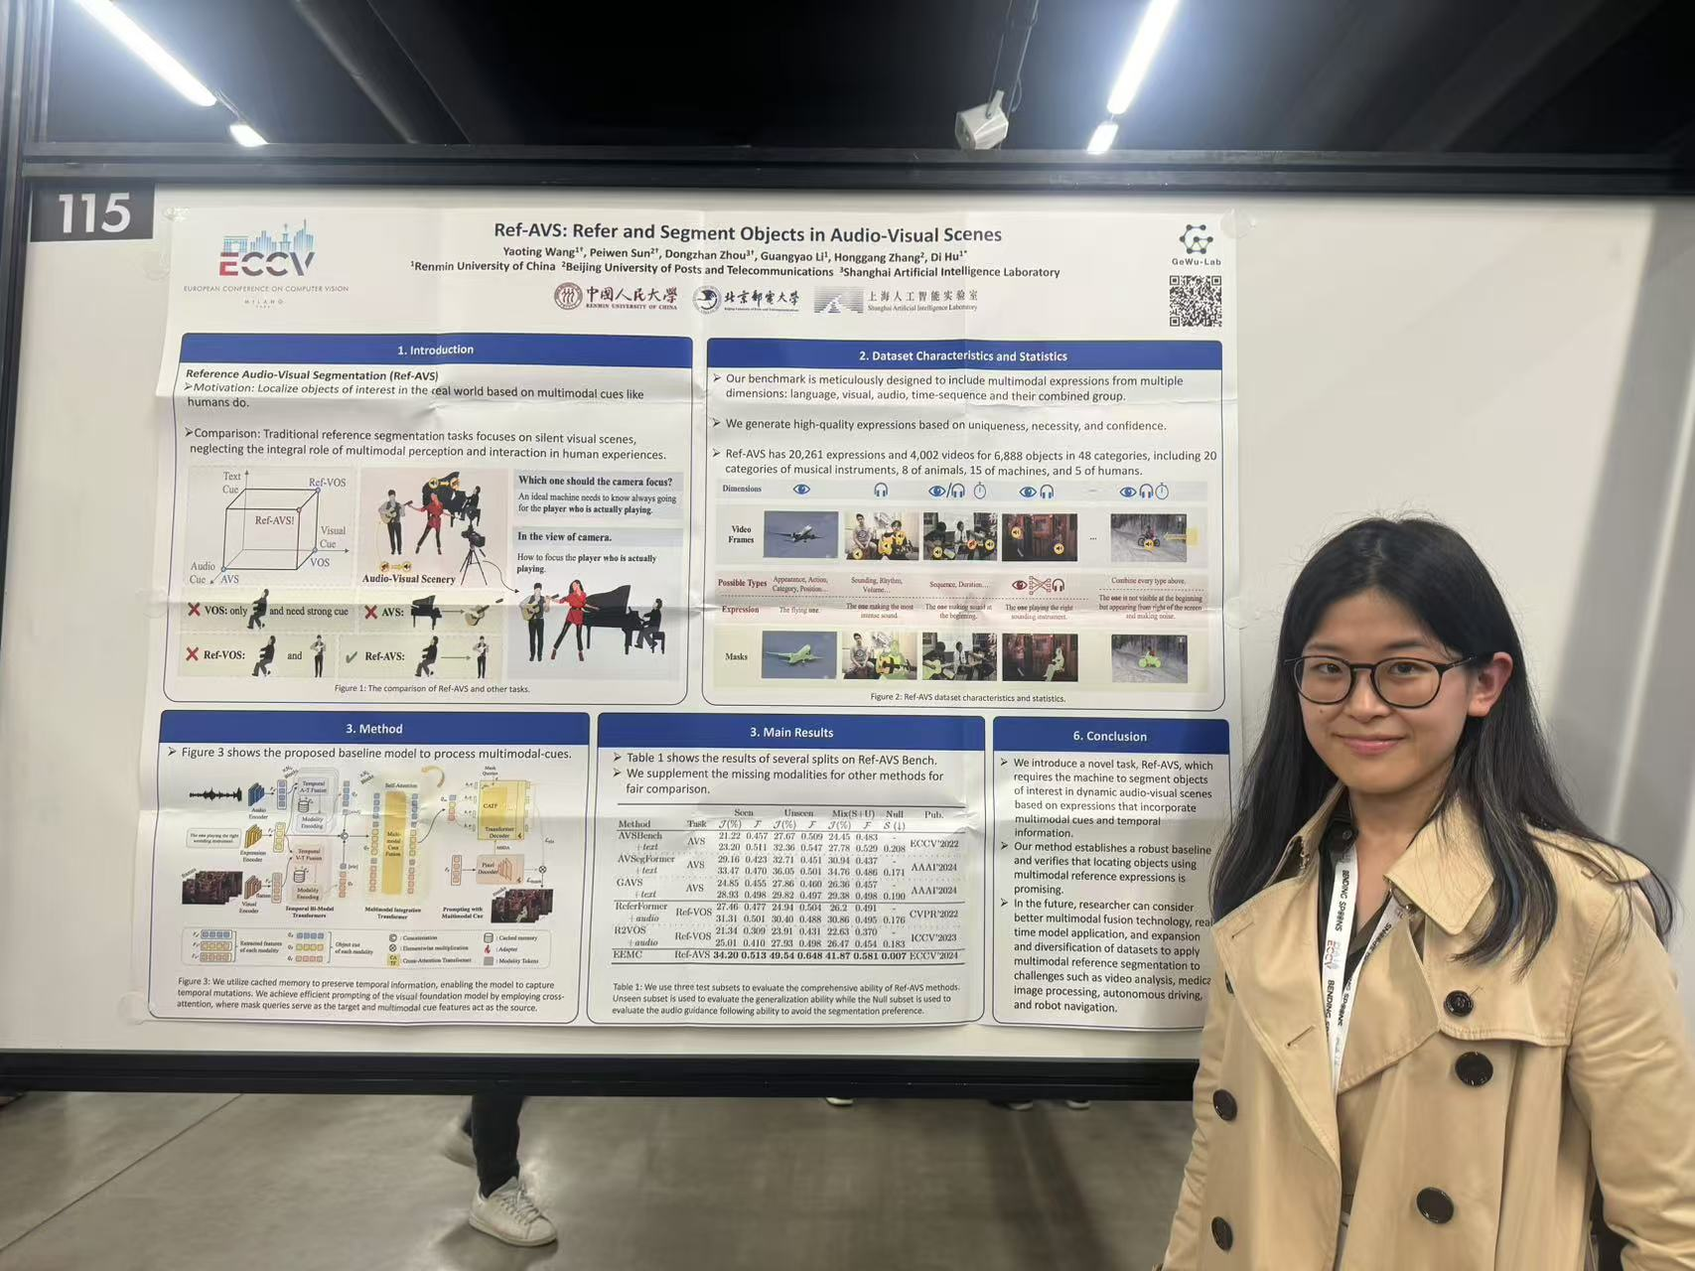
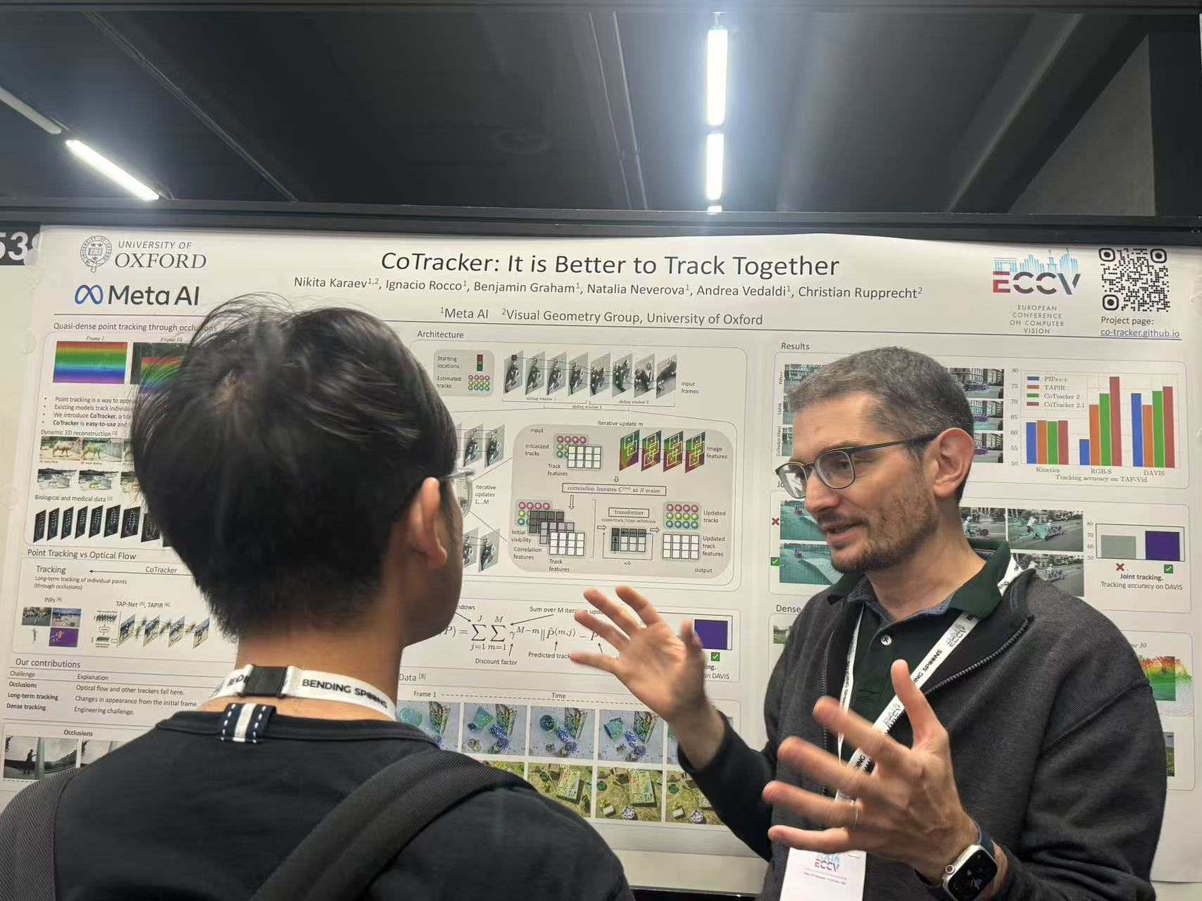


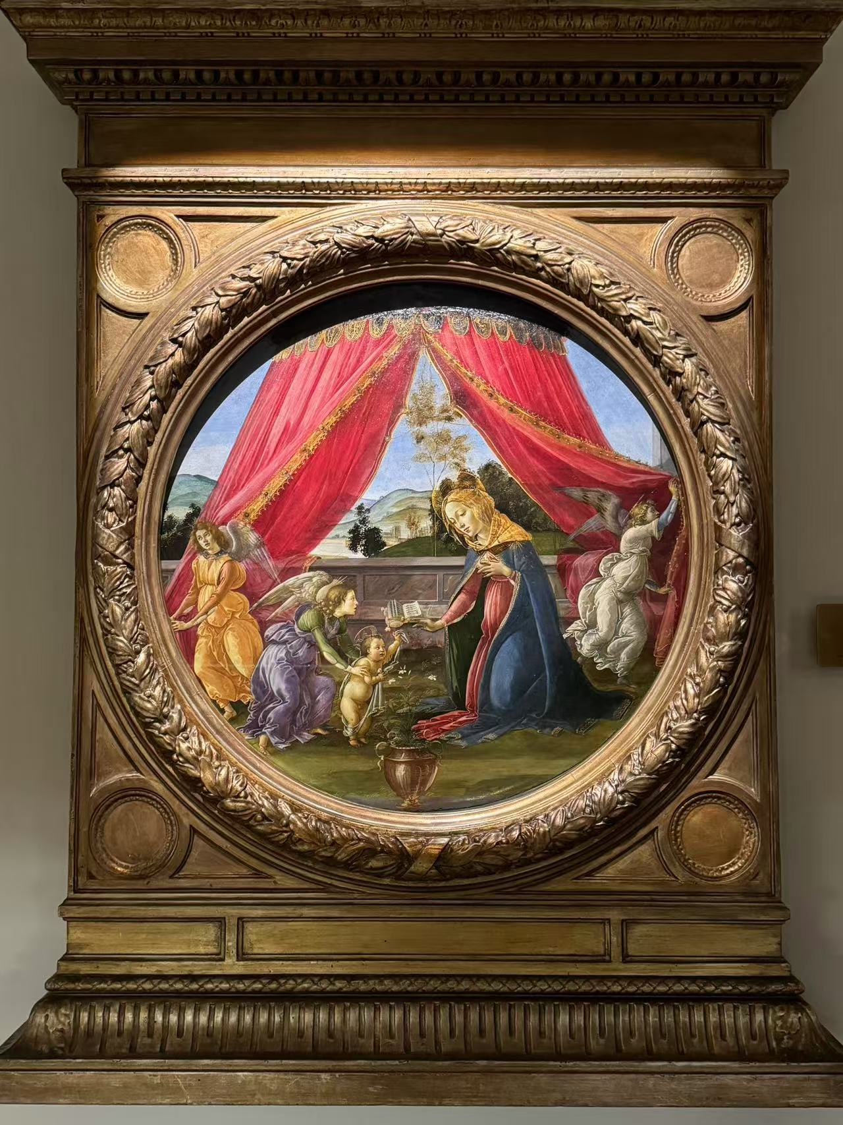
If your paper is accepted by a conference
ECCV 2024 Milan, Italy
Talks
Posters
And … of course, enjoy your trip!

Slide 13



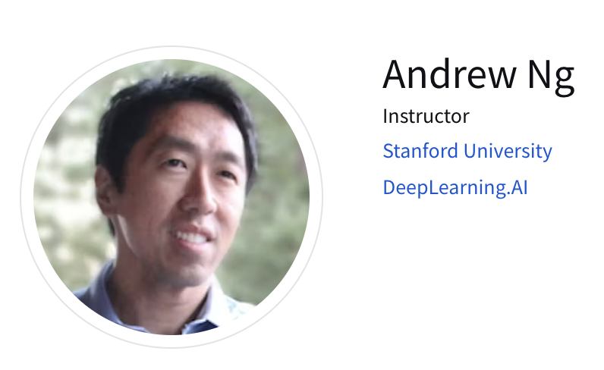
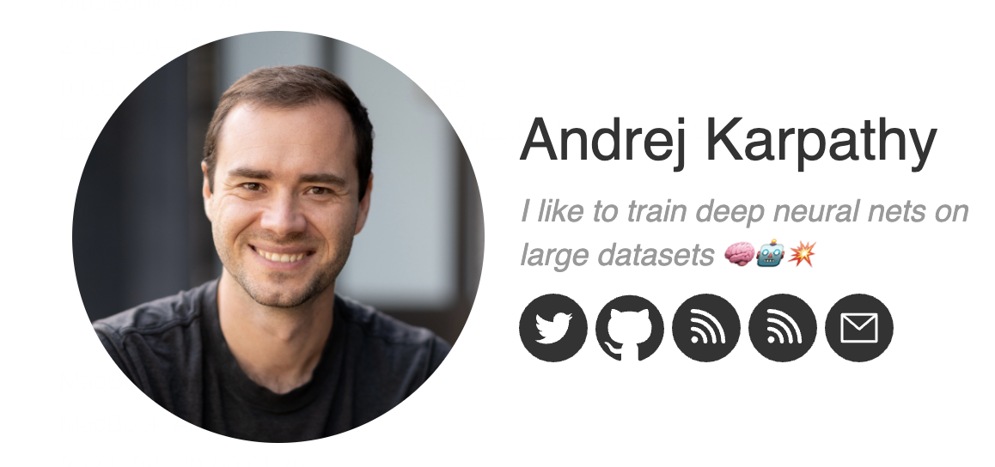

Impactful Social Media and KOLs
新时代三大顶会
Top AI Educators

Slide 14
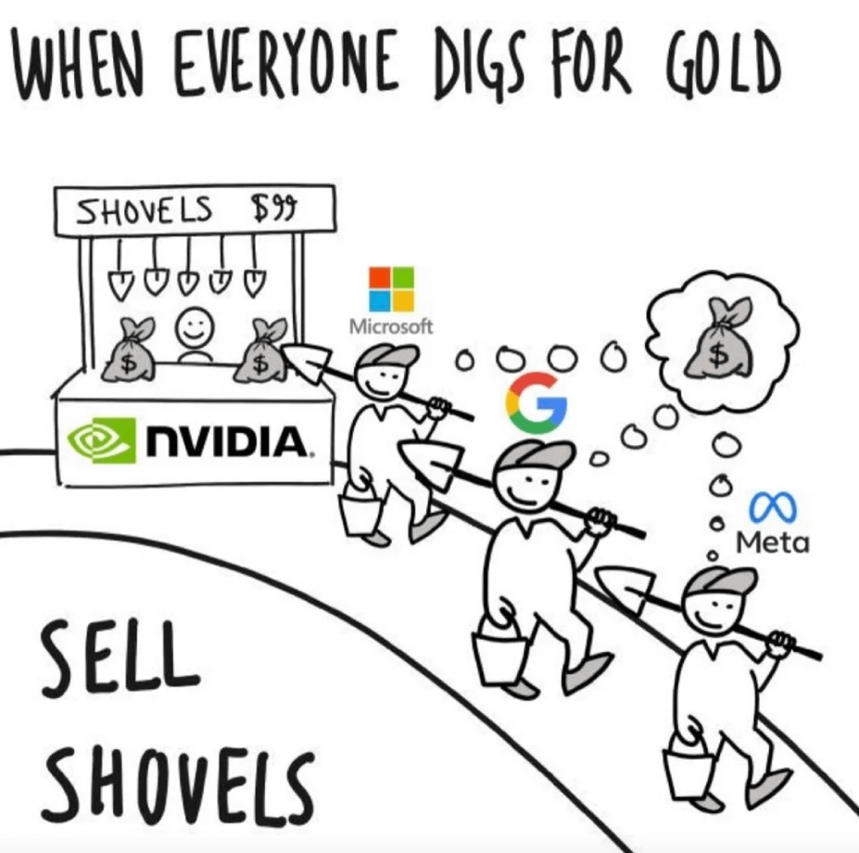
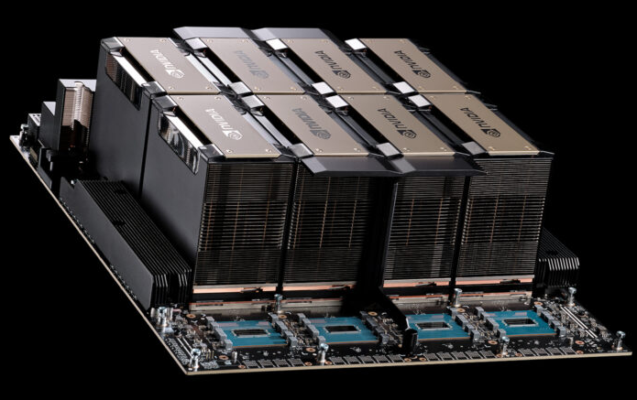
GPUs! More GPUs!
What is a GPU?
GPU (Graphics Processing Unit): Designed for parallel processing.
Initially created for rendering images and graphics.
Now widely used for compute-intensive tasks like AI and deep learning.
Why GPUs are so important to AI research?
High Parallelism (Thousands of Cores)
Massive Throughput (NV-Switch vs. PCI-e)
Optimized for Deep Learning Frameworks (CUDA and PyTorch)
Notes:
High Parallelism: GPU含有数千个计算核心，能够进行并行的计算，非常适合处理现代AI需要的矩阵和张量运算
Massive Throughput GPU对于数据的吞吐速度非常快，比如nv switch技术，是一种卡间互联的技术，对于大型模型的训练至关重要，nvswitch远远快于 pcie
Optimized for Deep Learning Frameworks：经过十几年的发展，GPU的并行计算框架相当多，适配良好，我们不需要重新去造轮子
下面给大家看了一张GPU服务器的图，上面是一些GPU，跟我们平时买的游戏显卡比如4090不一样，这种服务器级别的人工智能显卡不会自带风扇，是机箱里的暴力风扇直吹他的散热鳍片，下面我们可以看到一排芯片，这一排芯片就是nvswitch，用来绕开pcie总线，在显卡间以接近TB/s的速度，就是一秒可以传输1T数据，nvswitch就是传输数据的数据桥

Slide 15
GPU vs. CPU
Feature | GPU | CPU
AI Usability | Ideal for training and inference | Limited for heavy AI
Speed (AI Tasks) | Faster for large-scale tasks | Slower
Core Count | Thousands | Dozens
Processing Style | Parallel (many tasks) | Sequential (one task)
一个比喻：
GPU是数千个小学生，CPU是十个大学教授，十个教授在小学速算比赛里的计算速度远远慢于数千个小学生，但是再多的小学生也无法通过大学考试。

Slide 16
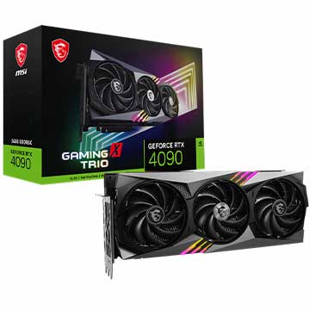
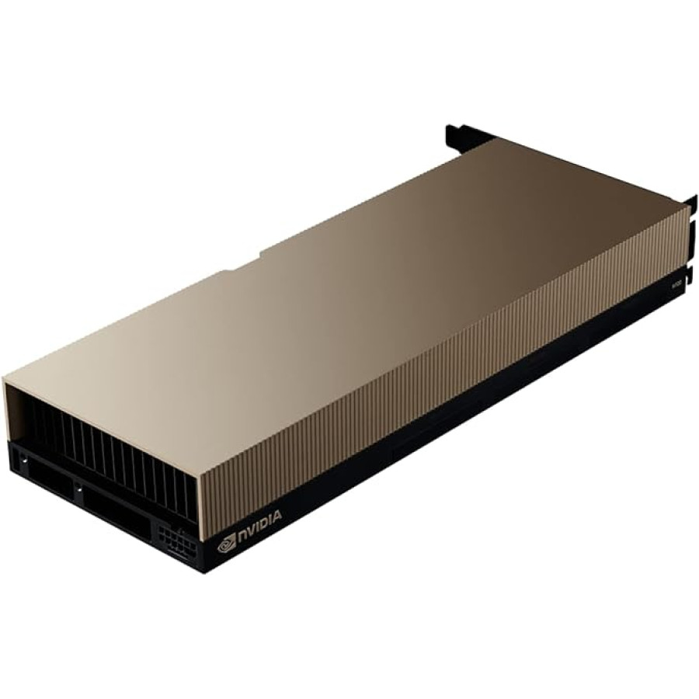
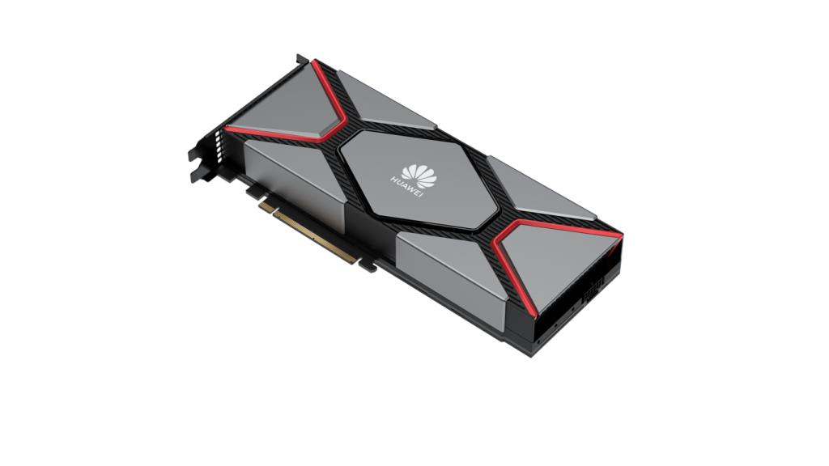
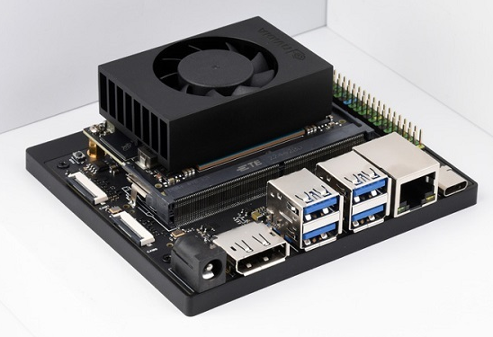






Various GPUs
Gaming GPU
Server GPU
Huawei NPU 910B
Edge GPU
Brands

Slide 17

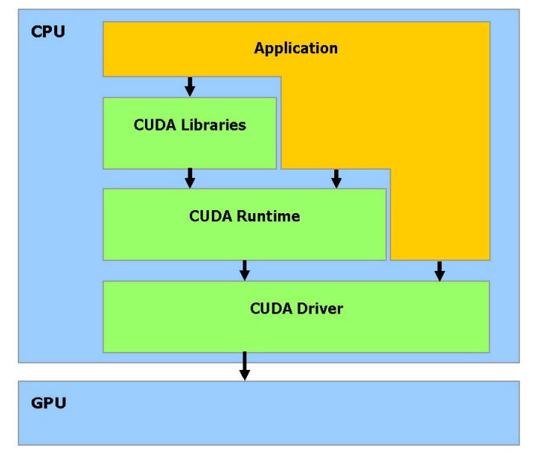


What is CUDA
CUDA
CUDA (originally Compute Unified Device Architecture) is a hardware API.
CUDA allows developers to leverage GPUs for high-performance computing(HPC) using languages like C, C++, and Python.
Competitors
AMD ROCm
Huawei Ascend CANN

Slide 18
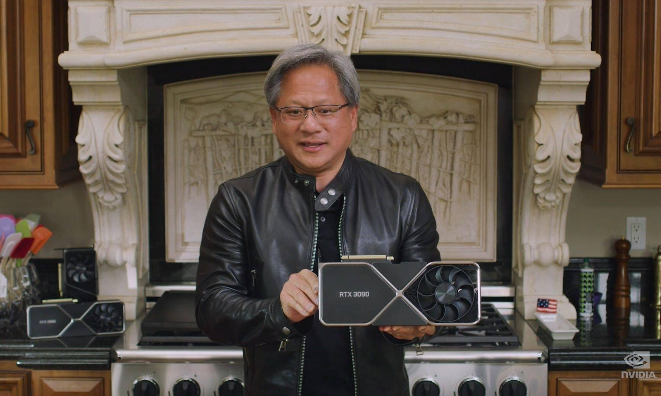
Where to find a GPU?
Buy your own GPU
Or Cloud GPUs
Google Colab (free)
HF Cluster (幻方萤火深度学习平台，free)
hfai上手视频
hfai使用文档
Others (paid)
AutoDL
矩池云

Slide 19
2 | History of AI

Slide 20
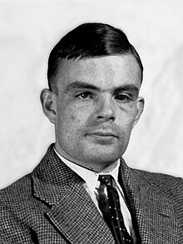
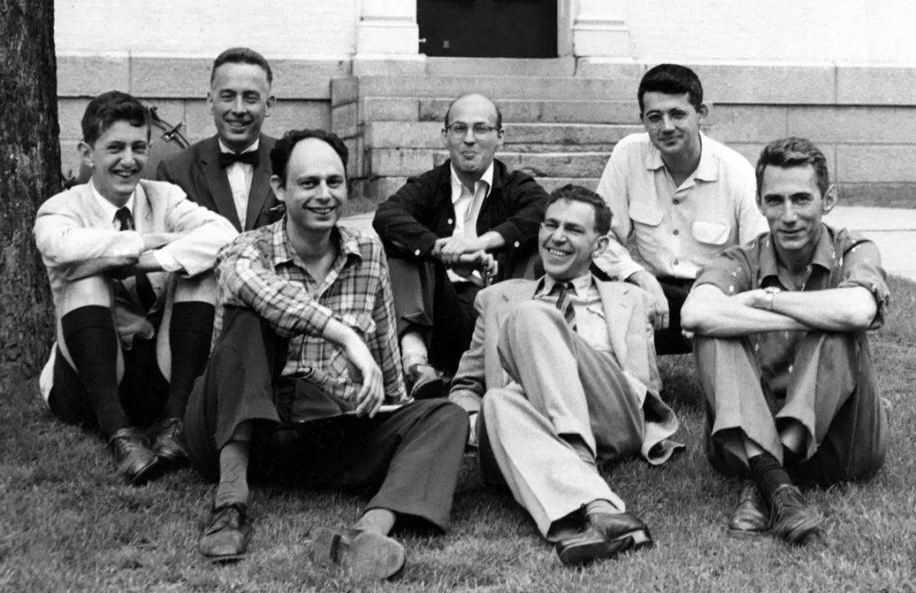
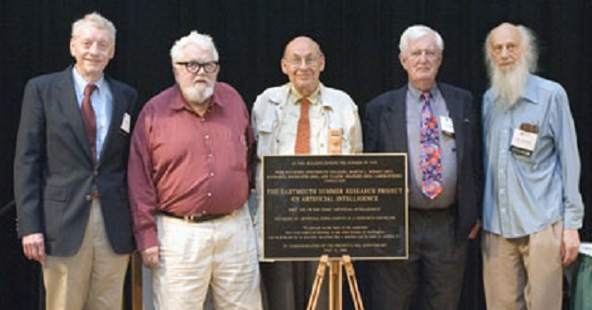
The Origin of AI
1950：Turing
Turing published "Computing Machinery and Intelligence" in Mind.
Firstly, raised the concept of AI.
1956：Dartmouth Workshop
The founding event of artificial intelligence as a field.
1956, Dartmouth Workshop
50th Anniversary, 2006
Claude Shannon
Alan Turing

Slide 21
Gartner Hype Cycle of Artificial Intelligence
The Development of AI Has Experienced Three Peaks and Two Degradations
Third Wave of AI
Deep Learning Era
Second Wave of AI
Expert Systems
Knowledge Engineering
Back Propagation
First Wave of AI
Dartmouth Workshop
The Golden Age
Rule-based Reasoning
Natural Language
Micro-worlds
Second AI Winter
Expensive Expert System
First AI Winter
Critiques on Connectionism
Computational Bottlenecks
Traditional Gartner Curve
Curve of AI
Anything valuable always comes with bubbles!
1956-1974
1980-1987
2011-Present
Notes:
事实上虽然这里没有提及，但是两次AI寒冬都和算力密切相关，第二次AI寒冬的开始是因为为专家系统设计的lisp机器过于昂贵，而购买个人电脑的用户则可以用很少的钱买到更多的计算能力，对用户来说，计算能力就是用户体验，因此在个人电脑兴起的时代，IBM在这个时候崛起了

Slide 22
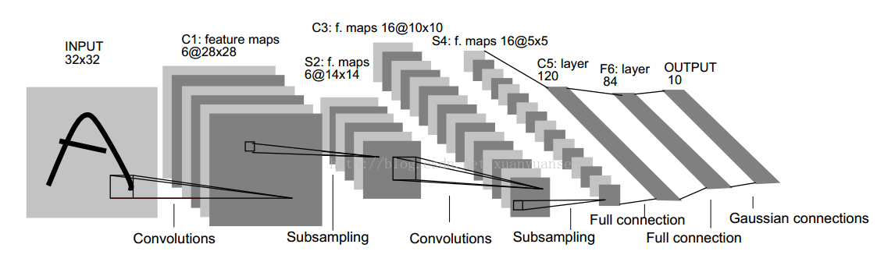

1993-2011 Era of Revival
Moore’s Law
Rapid advancements in computing hardware and GPUs.
In 1993, NVIDIA was founded.
In 1997, Deep Blue defeated Kasparov (World Chess Champion).
Statistical Learning and Machine Learning
SVM, published in 1995, cited more than 50k times.
LSTM, published in 1997, cited more than 70k times.
LeNet，One of the Earliest CNNs.
The Emergence of Deep Learning
LeCun, Convolutional Neural Networks (CNN).
Hinton, Deep Neural Networks.
Internet and bigdata, Fei-Fei Li launched ImageNet.
ImageNet: Image classification competition
Notes:
硬件持续上升->软件的可能性，这个逻辑可以keep
这个年代的成功案例：深蓝、指纹识别
提一下深蓝的原理是什么

Slide 23
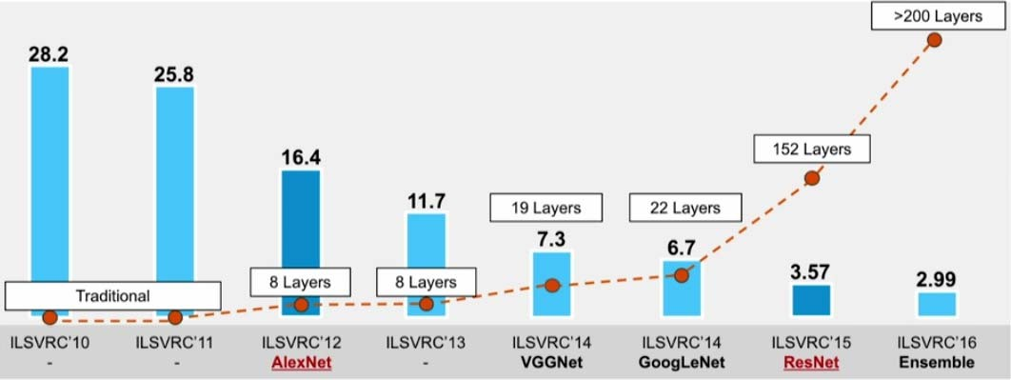
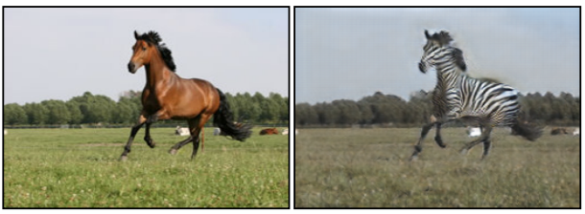
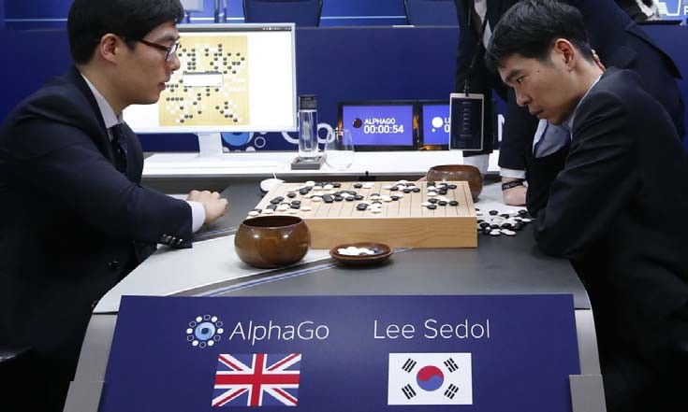
2011-Present：Prosperity of Deep Learning
Since 2012, Deep Learning achieves exciting breakthroughs every year.
2013 Word2vec The most successful word embedding technique, later won the NeurIPS Test of Time Award.
2015 ResNet solved the vanishing gradient problem and enabled extremely deep networks (up to hundreds of layers).
2017 Transformer was introduced, replacing RNNs and LSTMs in NLP, then became the most popular model.
2012 AlexNet
A deep CNN, AlexNet, won the first place in the ImageNet competition, far surpassing the SVM algorithm, indicating the beginning of the prosperity of deep learning.
2014 GAN proposed，later became the hottest Image generation model.
2016 AlphaGo defeated Lee Sedol, the world’s top professional Go player with a 4:1 victory.

Slide 24
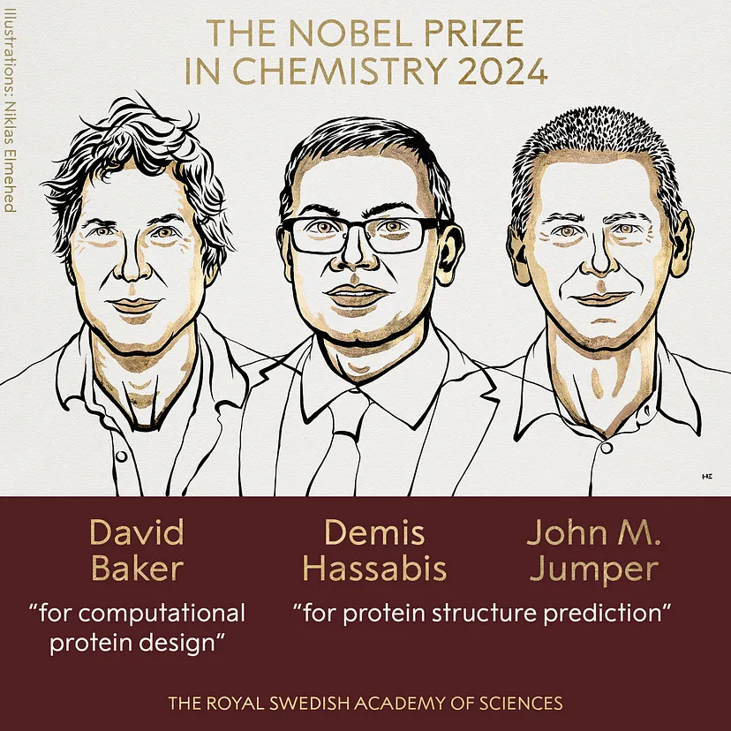
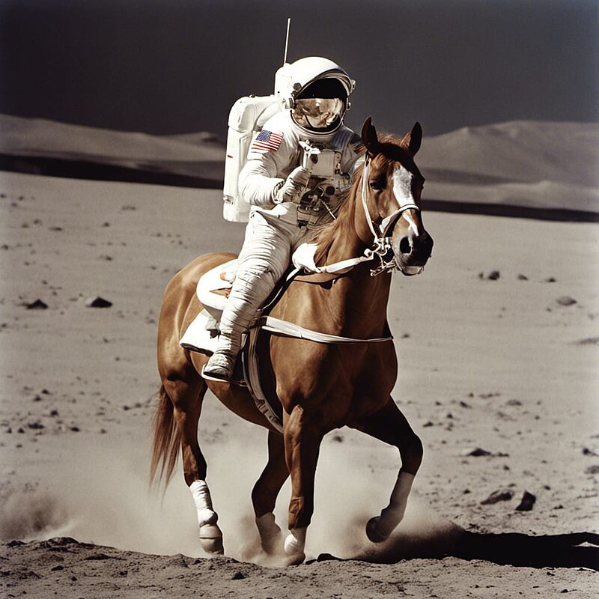
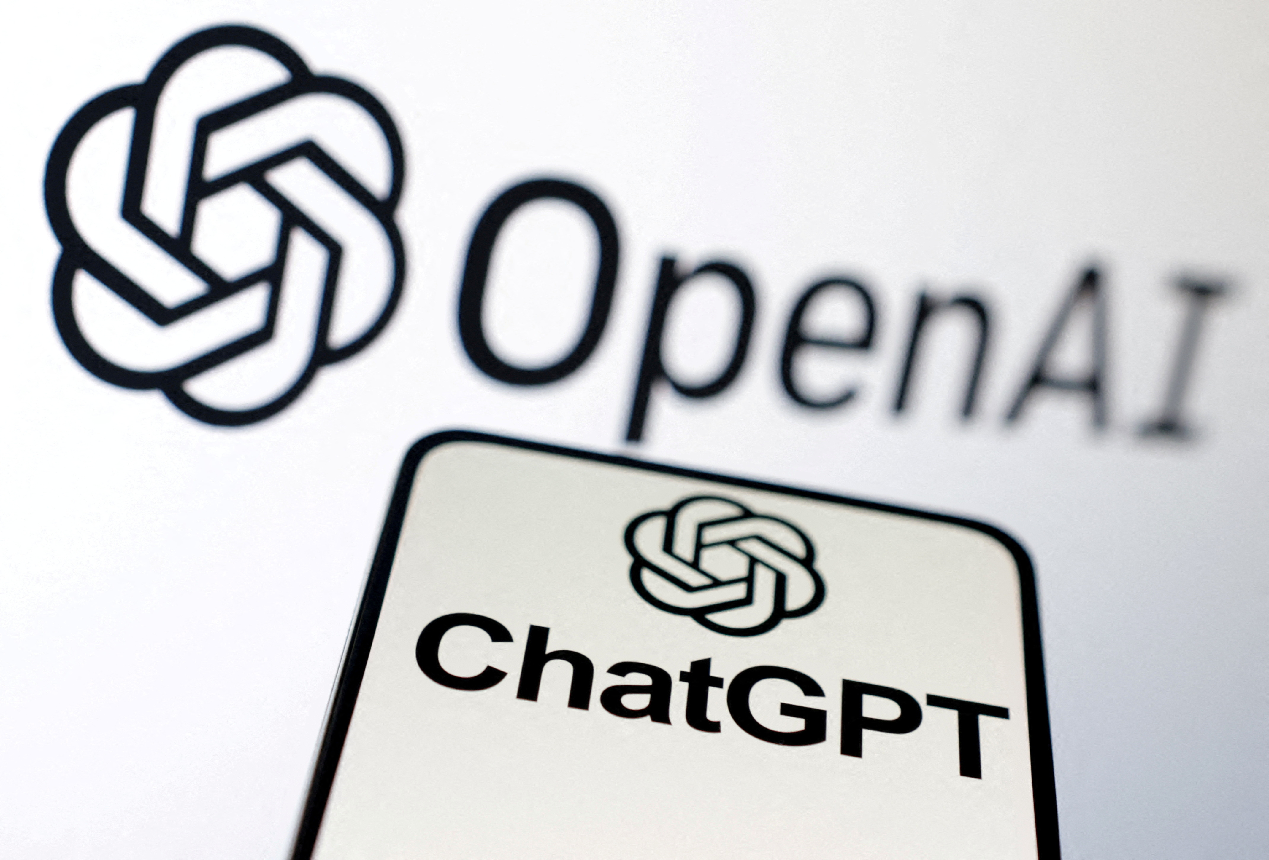
2011-Present：Prosperity of Deep Learning
Since 2012, Deep Learning achieves exciting breakthroughs every year.
2020 ViT Vision Transformer, bringing the Transformer architecture into the field of computer vision.
2021 Alphafold predicted protein structures through AI, earning the Nobel Prize in 2024.
2018 Pretrained Language Models Google introduced BERT. OpenAI released GPT-1. The beginning of large language models.
2020-2021 Diffusion Model revolutionized the quality of generated images
2022 ChatGPT released, regarded as the most disruptive AI model.
prompt
A horse-riding astronaut on the moon
Notes:
ViT算不算大的breakthrough
2019年有没有？
AI for Science是不是有
语音有没有

Slide 25





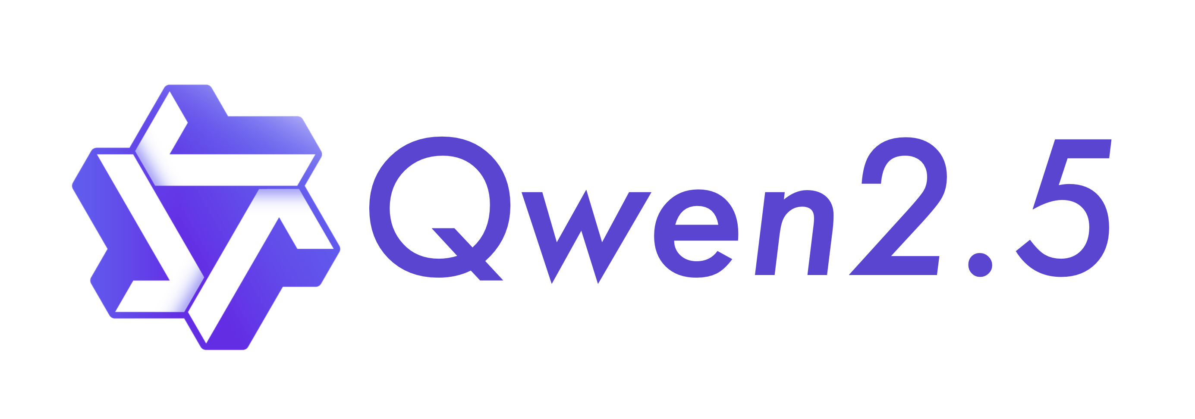



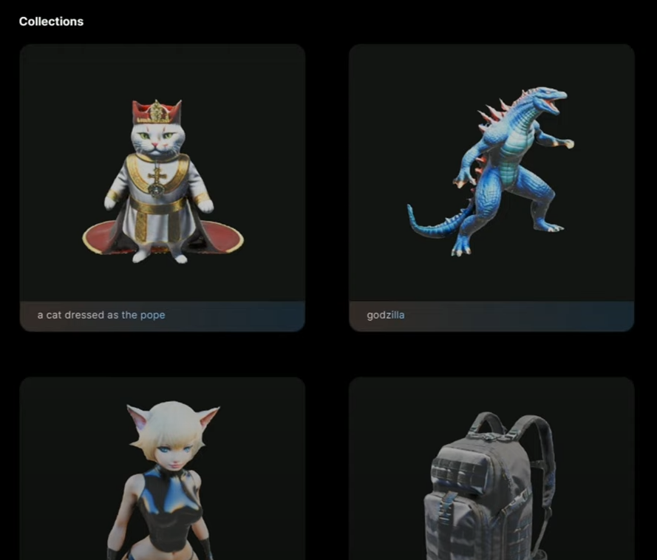



What AI can do now?
Lots of AIGC products
ChatBots
Productive Tools
Multimedia Generation

Slide 26
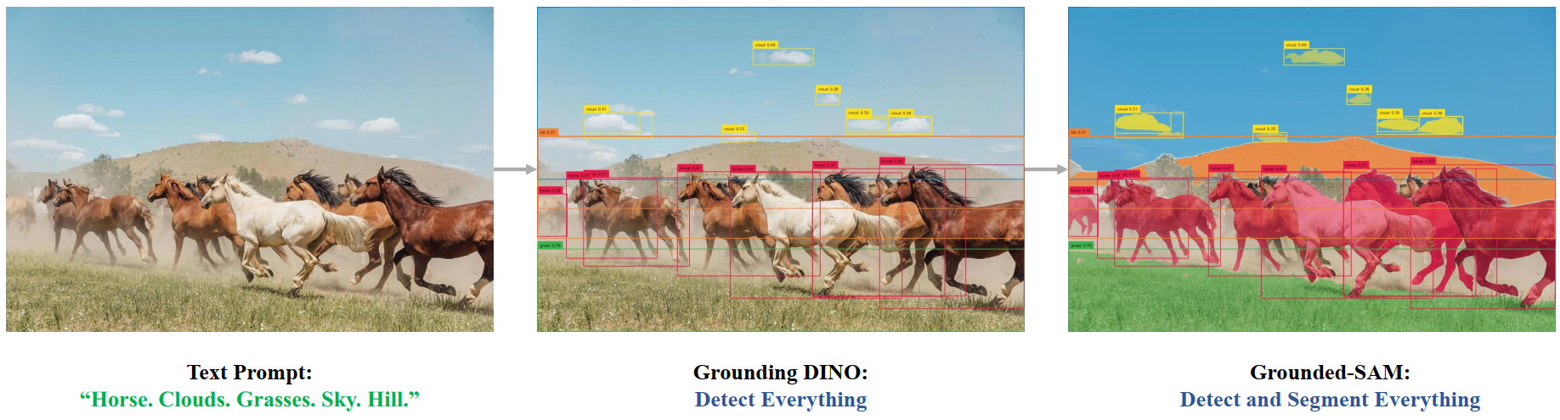
What AI can do now?
Understanding the world by detecting and segmenting anything.
Grounding DINO: Marrying DINO with Grounded Pre-Training for Open-Set Object Detection (ECCV 2024, Cited over 1k times.)
Grounded SAM: Assembling Open-World Models for Diverse Visual Tasks

Slide 27
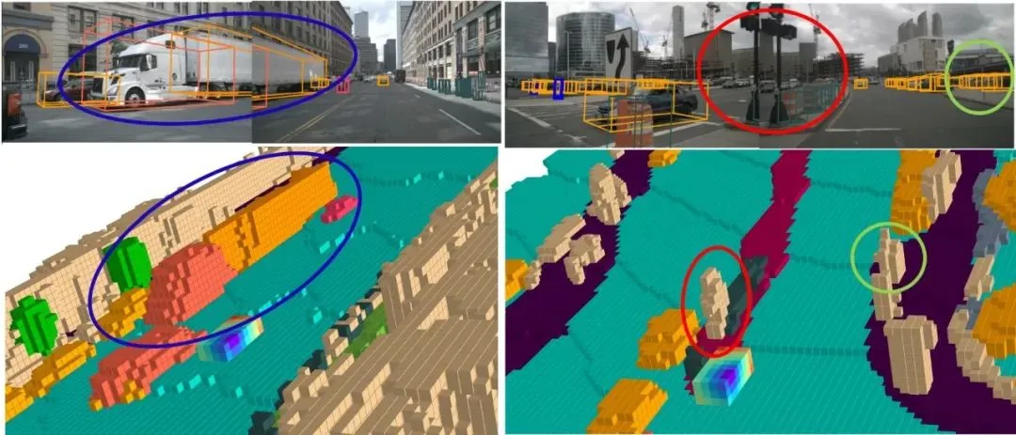
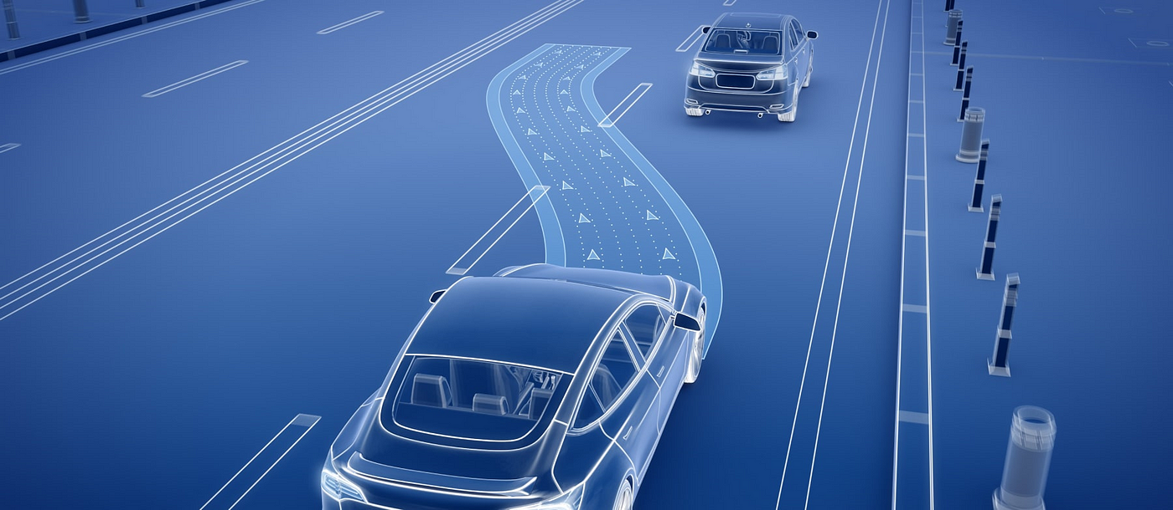
What AI can do now?
Autonomous Driving
Occupancy network and obstacle recognition
Path Planning

Slide 28
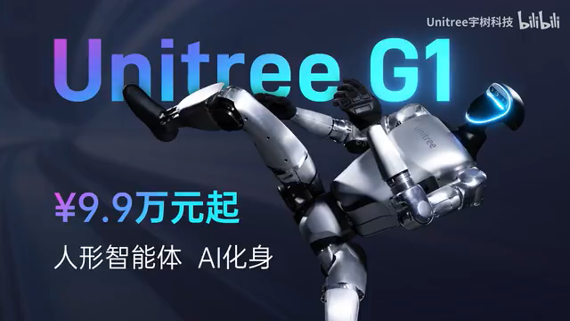
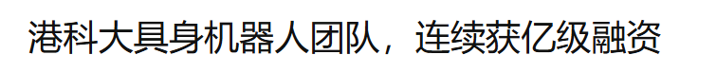
What AI can do now?
Embodied AI
Hottest fund-raising field this year!

Slide 29

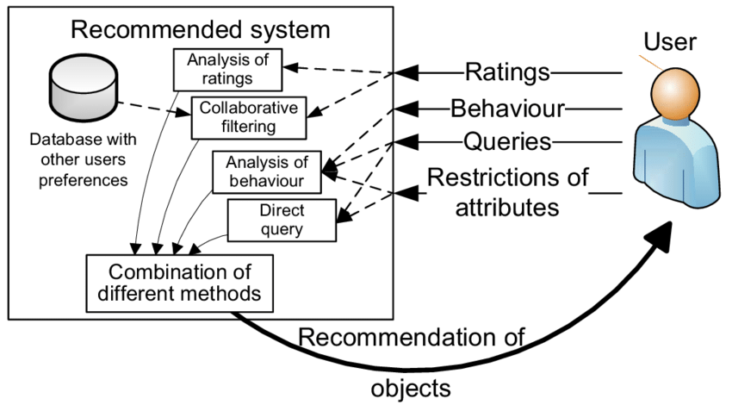
What AI can do now?
Recommendation System
Recommendation system is build mainly based on some vector or graph algorithms. But recently, the LLM-based recommendation system has emerged.

Slide 30

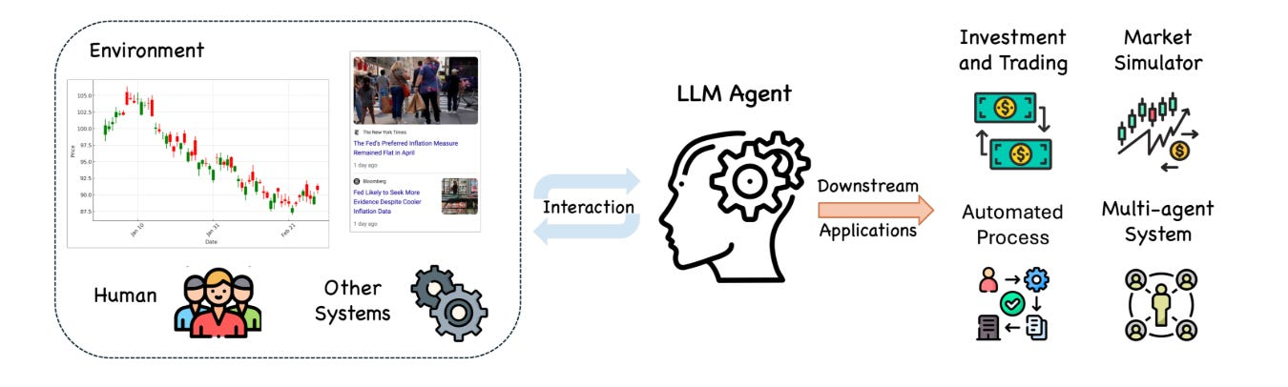
What AI can do now?
Making money
In recent years, technologies such as time-series transformers, LLMs, and multi-agent systems have been adopted in the field of financial investment, particularly in quantitative funds, achieving remarkable results.

Slide 31
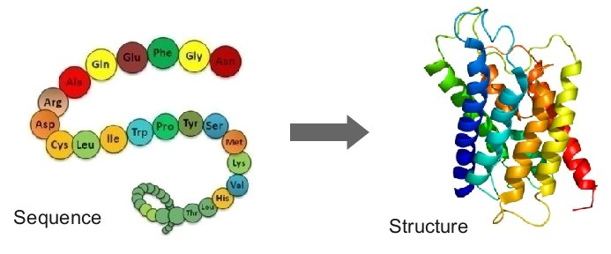
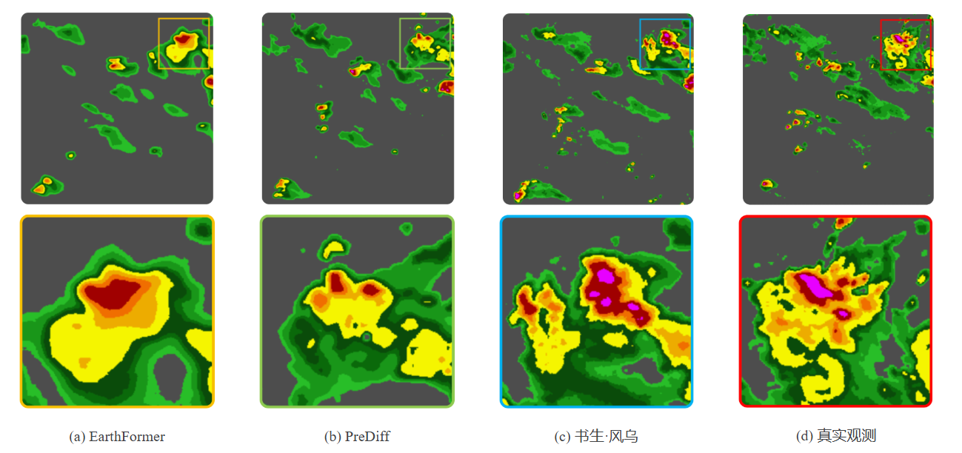

What AI can do now?
Predict protein structure, weather, molecule force
Protein Prediction
Precipitation Forecast
Accelerated Molecule Dynamics
Notes:
最好解释下什么叫分子动力学，其实就是计算某一个时间点每个分子受到的力，再根据牛顿力学计算出下一个时间点分子应该在什么位置

Slide 32
3 | Intro to Neural Networks

Slide 33



Types of Learning
Supervised Learning
Given these training data (X)
What are these? (y, label)
Goal: predict category y from image x
label
feature
y = f(x), f is the the model
$f\left(x\right)=softmax\left(x^{T}θ\right), θ$is the parameter/weight
y = f(x) → y = f(x; $θ$)
Given training data, find the best $θ$: optimization
Image copied from Prof Greg’s slides, thanks prof Greg!

Slide 34

Types of Learning
Supervised Learning
Label (y) is available in the training data
Types of y
Classification: if y is discrete: apple/pear/tomato
Regression: if y is continuous: price, sales, age
Notes:
强化学习框架不用太讲，可以给例子

Slide 35



Types of Learning
Unsupervised Learning
Label (y) is not available. Finding hidden patterns of data.
Notes:
强化学习框架不用太讲，可以给例子

Slide 36



Types of Learning
Self-supervised Learning
Only x is available, construct y from data.
Notes:
强化学习框架不用太讲，可以给例子

Slide 37



Types of Learning
Reinforcement Learning
In supervised learning, learn a probability $p\left(y | x\right)$
In a dynamic environment, learn a policy $π\left(a | x\right)$
Given state x，predict action a
AI Atari:
State: current snapshot of the game
Action: move left/ move right/ stay still
Notes:
强化学习框架不用太讲，可以给例子

Slide 38

Neural Network Algorithm
Feed forward
An ANN consists of connected units or nodes called artificial neurons, modelling the neurons in the brain.
Nodes are connected by edges, which model the synapses in the brain.
Non-linearity
The output of each neuron is computed by some non-linear function of the sum of its inputs, called the activation function.
Back propagation
The connections or the edges are learnable weights, usually optimized by back propagation and gradient descent.

Slide 39




Non-linear Function
ReLU
Rectified Linear Unit
$$ReLU\left(x\right)=max⁡(0,x)$$
Sigmoid
$$σ\left(x\right)=\frac{1}{1+e^{−x}}$$
Tanh
$$\tanh\left(x\right)=\frac{e^{x}−e^{−x}}{e^{x}+e^{−x}}=2∙σ\left(2x\right)−1$$
Why do we need Non-linearity?
Breaking Linear Boundaries
Universal Approximation

Slide 40








Neural Network Algorithm
$$1.1$$
$$σ\left(x\right)=\frac{1}{1+e^{−x}}$$
$$y=σ\left(1.1×0.2+\left(−1×0.4\right)+\left(−0.3\right)\right)$$
$$=σ\left(−0.48\right)$$
$$=\frac{1}{1+e^{0.48}}$$
$$=0.382$$
$$0.2$$
$$−1$$
$$0.4$$
$$y$$
$$−0.3$$
$$1$$

Slide 41




























Math in Neural Networks
Input Layer
Hidden Layer
Output Layer
$σ\left(x\right)=\frac{1}{1+e^{−x}}$
$a=σ(W_{1}∙x +b_{1})$
$o=σ\left(W_{2}∙a +b_{2}\right)$
i.e.
$a_{1}=σ\left(w_{1}^{1,1}∙x_{1}+w_{1}^{1,2}∙x_{2}+b_{1}^{1}\right)$
$a_{2}=σ\left(w_{1}^{2,1}∙x_{1}+w_{1}^{2,2}∙x_{2}+b_{1}^{2}\right)$
$a_{3}=σ\left(w_{1}^{3,1}∙x_{1}+w_{1}^{3,2}∙x_{2}+b_{1}^{3}\right)$
Or
$\left[\begin{matrix}o_{1} \\ o_{2}\end{matrix}\right]=σ\left(\left[\begin{matrix}w_{2}^{1,1} & w_{2}^{1,2} & w_{2}^{1,3} & b_{2}^{1} \\ w_{2}^{2,1} & w_{2}^{2,2} & w_{2}^{2,3} & b_{2}^{2}\end{matrix}\right]∙\left[\begin{matrix}a_{1} \\ a_{2} \\ \begin{aligned}a_{3} \\ 1\end{aligned}\end{matrix}\right]\right)$
$$a_{1}$$
$$w_{1}^{1,1}$$
$$x_{1}$$
$$w_{2}^{1,1}$$
$$w_{1}^{2,1}$$
$$w_{2}^{2,1}$$
$$a_{2}$$
$$w_{2}^{1,2}$$
$$o_{1}$$
$$w_{1}^{1,2}$$
$$w_{1}^{2,2}$$
$$x_{2}$$
$$w_{2}^{2,2}$$
$$w_{1}^{3,2}$$
$$w_{1}^{3,1}$$
$$w_{2}^{1,3}$$
$$b_{1}^{1}$$
$$b_{1}^{2}$$
$$a_{3}$$
$$w_{2}^{2,3}$$
$$o_{2}$$
$$b_{1}^{3}$$
$$1$$
$$b_{2}^{1}$$
$$b_{2}^{2}$$
$$1$$

Slide 42

Math in Neural Networks
Input Layer
Hidden Layer
Output Layer
Why do we need Non-linearity?
Overall
$$o=σ\left(W_{2}∙σ(W_{1}∙x +b_{1}) +b_{2}\right)$$
If there is no activation function:
$$o=W_{2}∙\left(W_{1}∙x +b_{1}\right) +b_{2}$$
$$=W_{2}∙W_{1}∙x+\left({W_{1}∙b}_{1}+b_{2}\right)$$
$$=W∙x+b$$
$$where W=W_{2}∙W_{1}, b={W_{1}∙b}_{1}+b_{2}$$
$$a_{1}$$
$$w_{1}^{1,1}$$
$$x_{1}$$
$$w_{2}^{1,1}$$
$$w_{1}^{2,1}$$
$$w_{2}^{2,1}$$
$$a_{2}$$
$$w_{2}^{1,2}$$
$$o_{1}$$
$$w_{1}^{1,2}$$
$$w_{1}^{2,2}$$
$$x_{2}$$
$$w_{2}^{2,2}$$
$$w_{1}^{3,2}$$
$$w_{1}^{3,1}$$
$$w_{2}^{1,3}$$
$$b_{1}^{1}$$
$$b_{1}^{2}$$
$$a_{3}$$
$$w_{2}^{2,3}$$
$$o_{2}$$
$$b_{1}^{3}$$
$$1$$
$$b_{2}^{1}$$
The neural network will degrade to a linear transformation without the activation function.
$$b_{2}^{2}$$
$$1$$

Slide 43




Train a Neural Network: XOR
$$x_{1}$$
$$w_{1}^{1,1}$$
$$a_{1}$$
Exclusive OR (XOR) truth table
$$w_{1}^{2,1}$$
$$w_{2}^{1,1}$$
$$w_{1}^{2,2}$$
Input x | Label y
[0,0] | 0
[0,1] | 1
[1,0] | 1
[1,1] | 0
$$w_{1}^{1,2}$$
$$x_{2}$$
$$a_{2}$$
$$w_{2}^{1,2}$$
$$o$$
$$b_{1}^{1}$$
$$b_{1}^{2}$$
$$b_{2}^{1}$$
$$1$$
$$1$$
Network Structure
$\left[\begin{matrix}a_{1} \\ a_{2}\end{matrix}\right]=σ\left(\left[\begin{matrix}w_{1}^{1,1} & w_{1}^{1,2} & b_{1}^{1} \\ w_{1}^{2,1} & w_{1}^{2,2} & b_{1}^{2}\end{matrix}\right]∙\left[\begin{matrix}x_{1} \\ x_{2} \\ 1\end{matrix}\right]\right)$
$o=σ\left(\left[\begin{matrix}w_{2}^{1,1} & w_{2}^{1,2} & b_{2}^{1}\end{matrix}\right]∙\left[\begin{matrix}a_{1} \\ a_{2} \\ 1\end{matrix}\right]\right)$
XOR is not linearly separable!
XOR Gate

Slide 44
















Train a Neural Network: XOR
$$x_{1}$$
$$w_{1}^{1,1}$$
$$a_{1}$$
Gradient Descent
Loss function: MSE (Mean Squared Error)
Loss is the distance between the output and the true label
$$L=\frac{1}{n}∑{\left(y−o\right)}^{2}$$
To find the best W to minimize the L:
$$W=W−η∙\frac{∂L}{∂W}$$
Using Back Propagation (BP) to calculate $\frac{∂L}{∂W}$
$η$is a hyper parameter, named learning rate
$$w_{1}^{2,1}$$
$$w_{2}^{1,1}$$
$$w_{1}^{2,2}$$
$$w_{1}^{1,2}$$
$$x_{2}$$
$$a_{2}$$
$$w_{2}^{1,2}$$
$$o$$
$$b_{1}^{1}$$
$$b_{1}^{2}$$
$$b_{2}^{1}$$
$$1$$
$$1$$
Network Structure
$\left[\begin{matrix}a_{1} \\ a_{2}\end{matrix}\right]=σ\left(\left[\begin{matrix}w_{1}^{1,1} & w_{1}^{1,2} & b_{1}^{1} \\ w_{1}^{2,1} & w_{1}^{2,2} & b_{1}^{2}\end{matrix}\right]∙\left[\begin{matrix}x_{1} \\ x_{2} \\ 1\end{matrix}\right]\right)$
$o=σ\left(\left[\begin{matrix}w_{2}^{1,1} & w_{2}^{1,2} & b_{2}^{1}\end{matrix}\right]∙\left[\begin{matrix}a_{1} \\ a_{2} \\ 1\end{matrix}\right]\right)$

Slide 45



















Train a Neural Network: XOR
$$x_{1}$$
$$w_{1}^{1,1}$$
$$a_{1}$$
Back Propagation - Layer 1
Back Propagate to $a=σ(W_{1}∙x +b_{1})$
$$\frac{∂L}{∂a}=\frac{∂L}{∂z_{2}}⋅\frac{∂z_{2}}{∂a}=\frac{∂L}{∂z_{2}}⋅W_{2}$$
Back Propagate to $z_{1}=W_{1}∙a +b_{1}$
$$\frac{∂L}{∂z_{1}}=\frac{∂L}{∂a}⋅\frac{∂a}{∂z_{1}}=\left[\frac{∂L}{∂z_{2}}⋅W_{2}\right]⋅\left(a⋅\left(1−a\right)\right)$$
Then we obtain the gradient of layer 1
$$\frac{∂L}{∂W_{1}}=\frac{∂L}{∂z_{1}}⋅\frac{∂z_{1}}{∂W_{1}}=\left[\frac{∂L}{∂z_{2}}⋅W_{2}\right]⋅\left(a⋅\left(1−a\right)\right)⋅x$$
$$\frac{∂L}{∂b_{1}}=\frac{∂L}{∂z_{1}}⋅\frac{∂z_{1}}{∂b_{1}}=\left[\frac{∂L}{∂z_{2}}⋅W_{2}\right]⋅\left(a⋅\left(1−a\right)\right)$$
Back Propagation - Layer 2
A desirable property of Sigmoid
$$σ^{′}\left(x\right)=σ\left(x\right)∙\left(1−σ\left(x\right)\right)$$
For a single data point:
$$\frac{∂L}{∂o}=−2(y−o)$$
Back Propagate to $z_{2}=W_{2}∙a +b_{2}$
$$\frac{∂L}{∂z_{2}}=\frac{∂L}{∂o}⋅\frac{∂o}{∂z_{2}}=−2\left(y−o\right)⋅(o⋅(1−o))$$
Then we obtain the gradient of layer 2
$$\frac{∂L}{∂W_{2}}=\frac{∂L}{∂z_{2}}⋅\frac{∂z_{2}}{∂W_{2}}=−2\left(y−o\right)⋅\left(o⋅\left(1−o\right)\right)⋅a$$
$$\frac{∂L}{∂b_{2}}=\frac{∂L}{∂z_{2}}⋅\frac{∂z_{2}}{∂b_{2}}=−2\left(y−o\right)⋅\left(o⋅\left(1−o\right)\right)$$
$$w_{1}^{2,1}$$
$$w_{2}^{1,1}$$
$$w_{1}^{2,2}$$
$$w_{1}^{1,2}$$
$$x_{2}$$
$$a_{2}$$
$$w_{2}^{1,2}$$
$$o$$
$$b_{1}^{1}$$
$$b_{1}^{2}$$
$$b_{2}^{1}$$
$$1$$
$$1$$
Network Structure
$a=σ(W_{1}∙x +b_{1})$
$o=σ\left(W_{2}∙a +b_{2}\right)$
$L=\frac{1}{n}∑{\left(y−o\right)}^{2}$
$W=W−η∙\frac{∂L}{∂W}$
$$\frac{∂L}{∂W}$$
？

Slide 46


Train a Neural Network: XOR
Exclusive OR (XOR) truth table
Input x | Label y
[0,0] | 0
[0,1] | 1
[1,0] | 1
[1,1] | 0
Network Structure
$\left[\begin{matrix}a_{1} \\ a_{2}\end{matrix}\right]=σ\left(\left[\begin{matrix}w_{1}^{1,1} & w_{1}^{1,2} & b_{1}^{1} \\ w_{1}^{2,1} & w_{1}^{2,2} & b_{1}^{2}\end{matrix}\right]∙\left[\begin{matrix}x_{1} \\ x_{2} \\ 1\end{matrix}\right]\right)$
$o=σ\left(\left[\begin{matrix}w_{2}^{1,1} & w_{2}^{1,2} & b_{2}^{1}\end{matrix}\right]∙\left[\begin{matrix}a_{1} \\ a_{2} \\ 1\end{matrix}\right]\right)$

Slide 47



Train a Neural Network: XOR
Network Structure
$a=σ(W_{1}∙x +b_{1})$
$o=σ\left(W_{2}∙a +b_{2}\right)$
$L=\frac{1}{n}∑{\left(y−o\right)}^{2}$
Back Propagation
$$\frac{∂L}{∂W_{2}}=\frac{∂L}{∂z_{2}}⋅\frac{∂z_{2}}{∂W_{2}}=−2\left(y−o\right)⋅\left(o⋅\left(1−o\right)\right)⋅a$$
$$\frac{∂L}{∂b_{2}}=\frac{∂L}{∂z_{2}}⋅\frac{∂z_{2}}{∂b_{2}}=−2\left(y−o\right)⋅\left(o⋅\left(1−o\right)\right)$$
$$\frac{∂L}{∂W_{1}}=\frac{∂L}{∂z_{1}}⋅\frac{∂z_{1}}{∂W_{1}}=\left[\frac{∂L}{∂z_{2}}⋅W_{2}\right]⋅\left(a⋅\left(1−a\right)\right)⋅x$$
$$\frac{∂L}{∂b_{1}}=\frac{∂L}{∂z_{1}}⋅\frac{∂z_{1}}{∂b_{1}}=\left[\frac{∂L}{∂z_{2}}⋅W_{2}\right]⋅\left(a⋅\left(1−a\right)\right)$$

Slide 48




Train a Neural Network: XOR
$W=W−η∙\frac{∂L}{∂W}$

Slide 49



Train Iris Data with
Anderson's Iris data set
The data set consists of 50 samples from each of three species of Iris (Iris setosa, Iris virginica and Iris versicolor). Totally 150 samples.
Four features were measured from each sample: the length and the width of the sepals and petals, in centimeters.
Notes:
Petal 花瓣，sepal花萼，setosa山鸢尾，主要生长在山地地区，versicolor 变色鸢尾，因为这种鸢尾花在不同种植环境下会变色，所以得名， virginica 维吉尼亚鸢尾，用他的原产地美国弗吉尼亚命名

Slide 50



Train Iris Data with
PyTorch
PyTorch is the most popular machine learning library.
The most user-friendly Python interface
Numpy-style tensor computing with strong GPU acceleration
Automatic differentiation system
High customizability with Numba CUDA
Install PyTorch
https://pytorch.org/get-started/locally/
Notes:
pytorch

Slide 51




Train Iris Data with
Data Preparation
Notes:
pytorch

Slide 52

Train Iris Data with
Train and test split
Why
Simulating real-world scenarios
Avoid selection bias
Training Data
Validation Data
Test Data
Training
Evaluation
Whole Dataset
Notes:
pytorch

Slide 53

Train Iris Data with
Define the Neural Network
Inherit nn.Module
Call the parent class nn.Module's initializer to set up base functionality.
Define the forward structure
Notes:
pytorch

Slide 54


Train Iris Data with
Initialize the model, define loss and optimizer
=4
=3
Softmax function
$$Softmax\left(x_{i}\right)=\frac{e^{x_{i}}}{\sum_{j}{e^{x_{j}}}}$$
Normalized exponential, can be regarded as a probability vector. i.e. [0.1, 0.5, 0.4]
Notes:
pytorch

Slide 55



Train Iris Data with
Cross Entropy
Is the distance between target distribution $P$ and predicted distribution $Q$
$$H\left(P,Q\right)=−\sum_{y}{P\left(y | x\right)\log{Q\left(y | x\right)}}$$
When $P$ is a one-hot vector
$$Loss=−\log{P_{model}\left(y | x\right)}$$
The closer 𝑃 and 𝑄 are, the smaller the loss becomes.
class 0 – Iris setosa
class 1 – Iris versicolor
class 2 – Iris virginica
For a sample of Iris setosa
$$P=[1, 0,0]$$
If:
$$Q=\left[0.1, 0.5, 0.4\right]$$
$$loss=−log0.1=2.3$$
If:
$$Q=\left[0.9, 0, 0.1\right]$$
$$loss=−log0.9=0.1$$
Notes:
pytorch

Slide 56

Train Iris Data with
Training
Feed forward
Auto differentiation
Notes:
pytorch

Slide 57

Train Iris Data with
Training
Notes:
pytorch

Slide 58

Using
For more examples, refer to
https://github.com/pytorch/examples
Notes:
pytorch

Slide 59
Dataset Split
Recall the hyperparameters in Iris training
The learning rate
The network depth
The activation function
The network width
The optimizer
…
How to optimize the hyperparameters?
Notes:
pytorch

Slide 60



Dataset Split
$θ$ is the trainable weights of the neural network.
$α$ is the hyperparameter.
Training Data
Validation Data
Test Data
$$α^{∗}=\underset{α}{argmin}{L_{val}\left(x | θ^{∗}(α),α\right)},$$
$$x∈val set$$
Training
Evaluation
Whole Dataset
$$Test Metric=L_{test}\left(x | θ^{∗}(α^{∗}),α^{∗}\right),$$
$$x∈test set$$
$$θ^{∗}\left(α\right)=\underset{θ}{argmin}{L_{train}\left(x | θ,α\right)}, x∈train set$$
Notes:
pytorch

Slide 61
Dataset Split
Training Data
Validation Data
Test Data
Training
Evaluation
Whole Dataset
Avoid Overfitting: The training set is used to optimize the learnable weights. Evaluating on the same data can lead to overfitting. The validation set ensures the model generalizes well.
Hyperparameter Tuning: The validation set is used to fine-tune hyperparameters, such as learning rate or model architecture, without contaminating the test set.
Unbiased Evaluation: The test set provides a final, unbiased assessment of model performance, simulating how the model performs on unseen data.
Generalization: Separating the datasets ensures that the model's performance is not artificially inflated by seeing the evaluation data during training or tuning.
Notes:
pytorch

Slide 62

Dataset Split – K-fold
Notes:
pytorch

Slide 63


However, data leakage of LLM
Data Leakage
Data leakage happens when your training data contains information about the target
LLMs
To train large language models, we have almost exhausted all the high-quality data available in the world. (It is not joking!)
It is difficult to claim that there still exists a truly unbiased test set for large language models.
Notes:
pytorch

Slide 64


Bias-Variance Tradeoff
Definition
Bias: Error due to overly simplistic assumptions in the model
Variance: Error due to model's sensitivity to small fluctuations in the training data.
Takeaway
Low Complexity → High Bias, Low Variance (Underfitting).
High Complexity → Low Bias, High Variance (Overfitting).
Ideal Model: Optimal Complexity (Lowest Test Error).
Notes:
pytorch

Slide 65


Overfitting vs. Underfitting
Overfitting
Model captures noise instead of patterns in data.
Low Bias, High Variance.
Excellent performance on training data but poor on test data.
Example: Very complex polynomial for simple data.
Underfitting
Model is too simple to capture underlying patterns.
High Bias, Low Variance.
Poor performance on both training and test data.
Example: Linear model for non-linear data.
Notes:
pytorch

Slide 66
Mitigating Overfitting and Underfitting
Key Questions
Is the model too simple or too complex?
How does the model perform on unseen data?
In the era of deep learning, we face overfitting more than underfitting.
We will mention details about how to deal with overfitting of deep neural networks in following weeks.
Strategy
For Underfitting: Increase model complexity, use richer features.
For Overfitting: Regularization, reduce model complexity, more data, cross-validation.
Notes:
pytorch

Slide 67

What a DL engineer is doing every day
Notes:
pytorch

Slide 68
What a DL researcher is doing every day
Programming
Browse Github and HuggingFace to find sth. interesing
Git clone and import torch, instructed by github copilot
Data
We need data, data, data! AS CLEAN AS POSSIBLE!
Brainstorms
Arguing whether SGD or Adam works better for the new model.
“Can this be extended to work on video and multimodal data?”
Supervising interns: “****, you should never write codes like that.”
Papers
Skim arXiv for new papers, and questioning: “How does this paper is accepted by CVPR/NeurIPS/ICLR…?”
Try to understand and correct the puzzling manuscript produced by interns
Notes:
pytorch

Slide 69
Thank you

Slide 70


主色
辅助色
通用辅助色
p.s.
任何需要的颜色可以直接
使用吸管工具吸取哦
C 99 / M 84 / Y 0 / K 0
R 22 / G 56 / B 160
#1638a0
C 100 / M 99 / Y 43 / K 1
R 23 / G 32 / B 113
#172071
C 74 / M 59 / Y 37 / K 0
R 92 / G 105 / B 132
#5c6984
C 75 / M 69 / Y 68 / K 31
R 68 / G 68 / B 68
#444442
C 71 / M 63 / Y 60 / K 14
R 89 / G 89 / B 89
#595959
C 76 / M 69 / Y 67 / K 30
R 67 / G 69 / B 69
#434545

Slide 71
这是一段大标题
小标题
上海人工智能实验室致力于打造“突破型、引领型、平台型”一体化的大型综合研究基地
目标建成国际一流的人工智能实验室
【图】
小标题
上海人工智能实验室致力于打造“突破型、引领型、平台型”一体化的大型综合研究基地
目标建成国际一流的人工智能实验室

Slide 72






这是一段大标题
小标题
上海人工智能实验室致力于打造“突破型、引领型、平台型”一体化的大型综合研究基地
目标建成国际一流的人工智能实验室
小标题
上海人工智能实验室致力于打造“突破型、引领型、平台型”一体化的大型综合研究基地
目标建成国际一流的人工智能实验室
小标题
上海人工智能实验室致力于打造“突破型、引领型、平台型”一体化的大型综合研究基地
目标建成国际一流的人工智能实验室

Slide 73

这是一段大标题
 |  | 指标一 |  | 指标二
 |  | ✓ |  | ✓
 |  | ✓ |  | ✓
 |  | ✓ |  | ✓
 |  | ✓ |  | ✓
指标一 |  | ✓ |  | ✓
 |  | ✓
 |  | ✓
 |  | ✓
 |  |  |  | ✓
 |  |  |  | ✓
 |  | ✓
指标二 |  | ✓ |  | ✓
 |  | ✓ |  | ✓
05
这是一些数值说明
这是一些数值说明
04
这是一些数值说明
03
这是一些数值说明这是一些数值说明
这是一些数值说明
这是一些数值说明
这是一些数值说明
02
01
这是一些数值说明
©2020 Visa. All rights reserved.

Slide 74



这是一段大标题
小标题
上海人工智能实验室致力于打造“突破型、引领型、平台型”一体化的大型综合研究基地
目标建成国际一流的人工智能实验室
小标题
上海人工智能实验室致力于打造“突破型、引领型、平台型”一体化的大型综合研究基地
目标建成国际一流的人工智能实验室

Slide 75
这是一段大标题
企业形象优势
产品优势详细说明产品优势详细说明
产品定位优势
产品优势详细说明产品优势详细说明
综合实力优势
产品优势详细说明产品优势详细说明
产品体验优势
产品优势详细说明产品优势详细说明
优势
Enterprise advantages
企业营销优势
产品优势详细说明产品优势详细说明
制造成本优势
产品优势详细说明产品优势详细说明

Slide 76
这是一段大标题
小标题
小标题
小标题
上海人工智能实验室致力于打造“突破型、引领型、平台型”一体化的大型综合研究基地，目标建成国际一流的人工智能实验室
上海人工智能实验室致力于打造“突破型、引领型、平台型”一体化的大型综合研究基地，目标建成国际一流的人工智能实验室
上海人工智能实验室致力于打造“突破型、引领型、平台型”一体化的大型综合研究基地，目标建成国际一流的人工智能实验室

Slide 77
素材：icon（www.iconfont.cn免费素材）

Slide 78
素材：icon（www.iconfont.cn免费素材）

